Slide 1

Microsoft Word 2007 – Level 2
Chapter 4
CUSTOMIZING AND NAVIGATING IN A DOCUMENT

Slide 2

Performance Objectives
Create custom theme colors, theme fonts, and theme effects
Save a custom theme
Apply, edit, and delete custom themes
Reset to the template theme
Change the Quick Styles set default
Apply styles
Create new styles and create styles from existing formatting
Save and delete a custom Quick Styles set
Navigate in a document using Document map, Thumbnails, bookmarks, hyperlinks, and cross-references
Insert hyperlinks to a location in the same document, a different document, a file in another program, or a site on the Internet

Slide 3

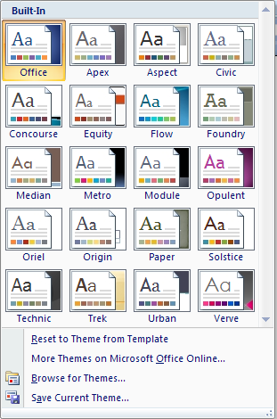
Customizing Themes
A Theme is
Page Layout tab
… a combination of theme colors, theme fonts, and theme effects
… stored in the Themes drop-down gallery

Slide 4
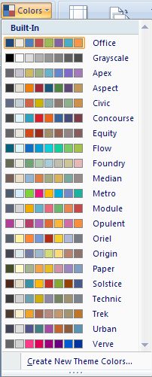
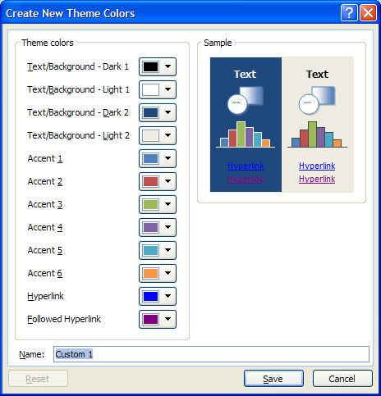
Creating Custom Theme Colors
Page Layout tab, Colors
Choose Colors, Name, and Save
Click to create your own

Slide 5
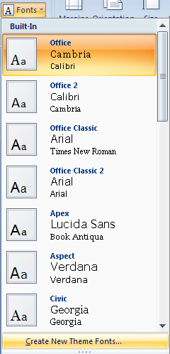
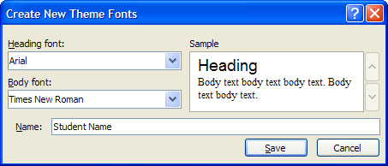
Creating Custom Fonts
Page Layout tab, Fonts
Choose Heading font and Body font
Click to create custom font
Enter Name and click Save.

Slide 6
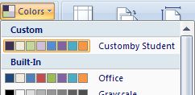
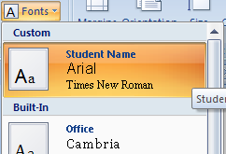
Applying Custom Theme Colors & Fonts
Page Layout tab, Colors
Custom Color set appears at top of Colors list
Custom Font set appears at top of Fonts list

Slide 7
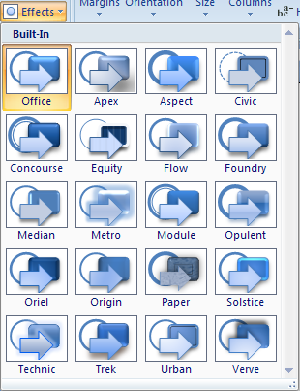
Applying Theme Effects
Page Layout tab, Effects
Theme effects are sets of lines and fill effects
Although you cannot create your own set of theme effects, you can choose the one that you want to use in your own document theme

Slide 8
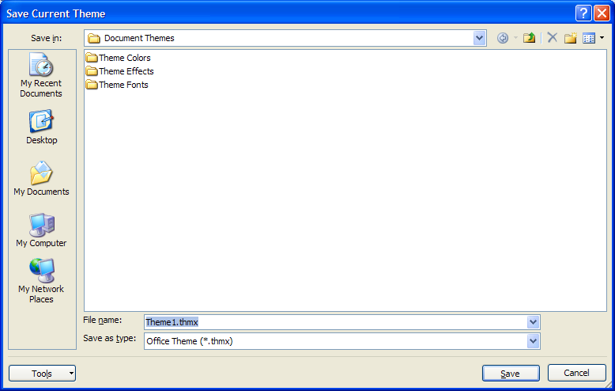
Saving a Document Theme
Page Layout tab, Themes
After setting the
colors, fonts,
and effects,
click Save Current Theme…
Enter Name and click Save

Slide 9
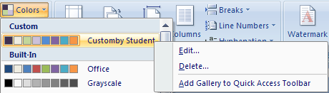
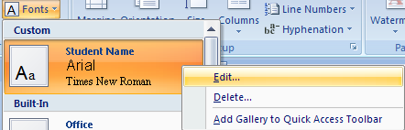
Editing Custom Themes
Page Layout tab, Colors
To edit,
right-click
custom color or font set, then click Edit…
Page Layout tab, Fonts

Slide 10
Resetting to Template Theme
Page Layout tab, Themes
To reset the theme for the current document,
click

Slide 11
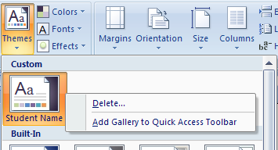
Deleting Custom Themes
Page Layout tab, Themes
To delete a custom theme,
right-click
the theme
and click

Slide 12

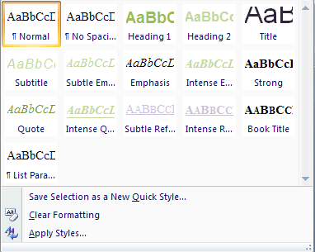
Formatting with Styles
A Style is
Home tab
… a set of text formatting instructions
… stored in the Styles drop-down gallery
Default Quick Style Set

Slide 13
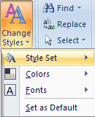
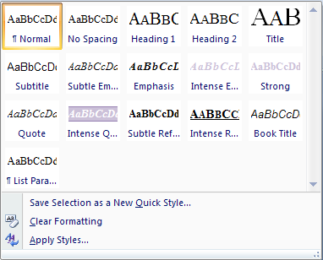
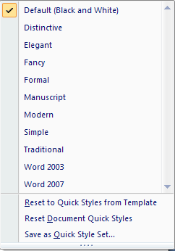
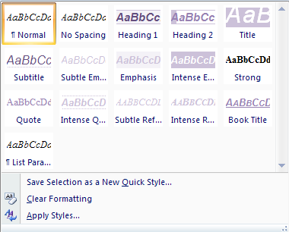
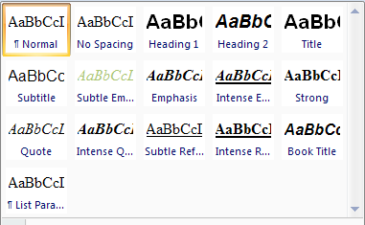
Changing the Quick Styles Set Default
Choose a
style set
Home tab,
Change
Styles,
Style Set
After choosing a style set, click Change Styles,
Set as Default

Slide 14
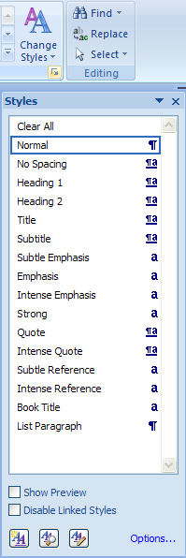

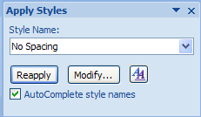

Applying Styles
Ways to apply styles …
1. Click desired style in ribbon
3. Use Styles Task Pane
2. Select text,
Click desired style
using Mini toolbar
Hover mouse over each item to show Font, Line Spacing, Paragraph spacing,
then click choice
4. Apply Styles Window

Slide 15

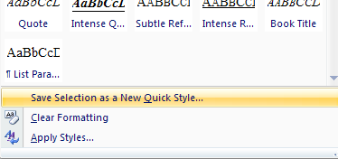
Creating a Style
… based on existing Formatting or Style
Apply desired formatting or Style to text, then
Select the text and
click the More button
(in the Styles Group)
Click

Slide 16
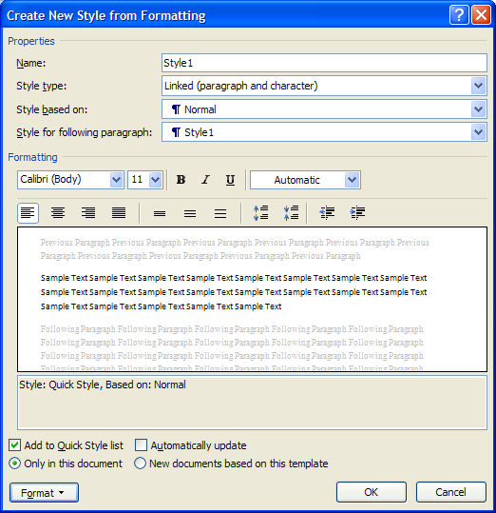
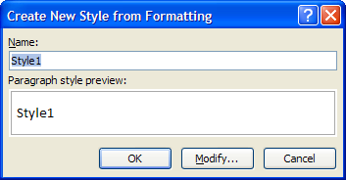
Creating a Style …/2
... after clicking
Save Selection as a New Quick Style …
Enter name
and click OK
or Modify
Make changes and click OK

Slide 17
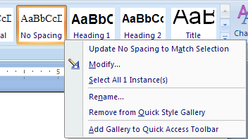
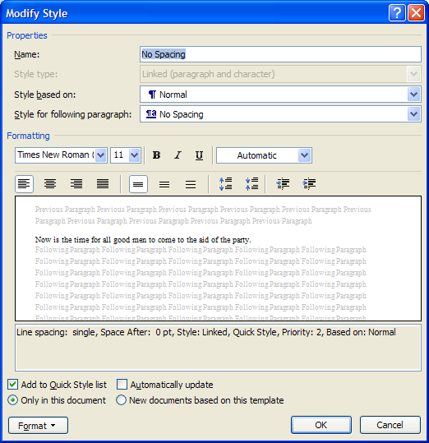
Modifying a Style
Right-click an existing Style to change it
Click
Type new name for style, make changes, click OK

Slide 18
Saving a Custom Style Set
Home tab,
Change Styles,
Style Set
Click
Saving the Style set makes it
available to other documents

Slide 19
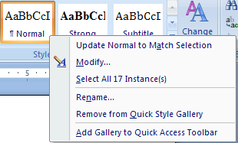
Selecting Occurrences of a Style
Selecting Occurrences of a Style
Right-click the Style, then
Click
WORD will select all occurrences
so all can be reformatted at once

Slide 20
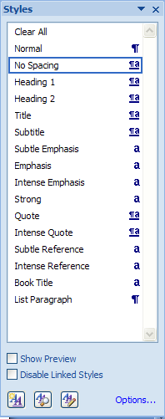
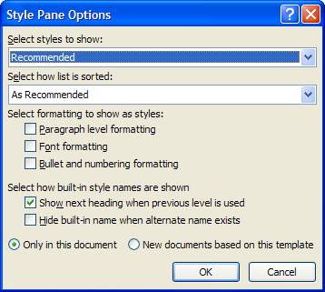
Displaying All Styles
Click the Styles Group dialog box launcher
Styles Task Pane
Click
Options

Slide 21
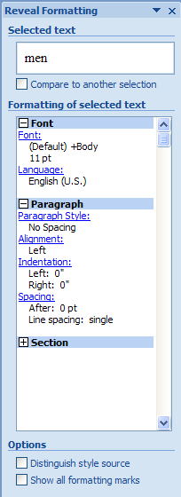
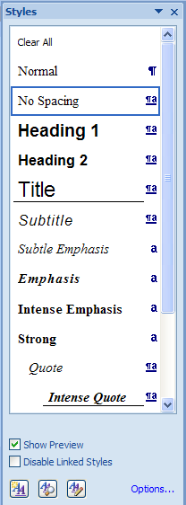
Reveal Style Formatting
Show text formatting …
OR
Click Show Preview check box in Styles task pane
Shift + F1
to display Reveal Formatting task pane

Slide 22
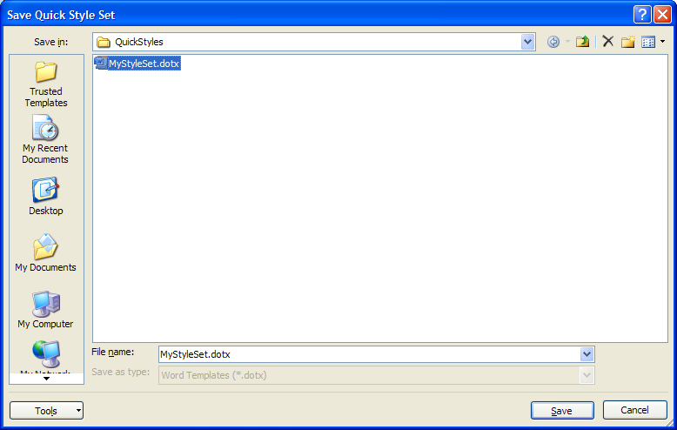
Deleting a Custom Style Set
Home tab,
Change Styles,
Style Set
Select and delete
Click

Slide 23
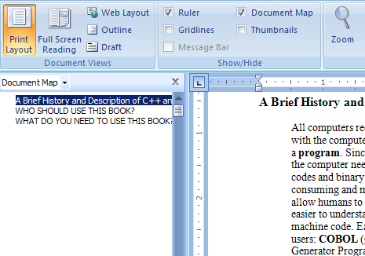
Navigation with Document Map
Click the View tab
Click Document Map
Click
this heading to go to it
Shows text formatted as headings

Slide 24
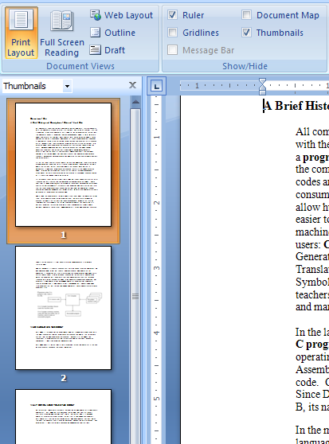
Navigation with Thumbnails
Click the View tab
Click the Thumbnails check box
(displays the Thumbnails pane)
Click
this page to view it

Slide 25

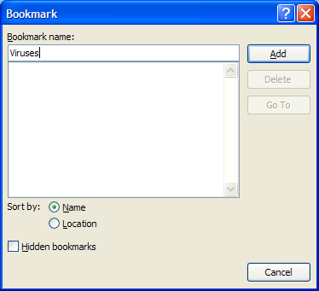
Navigation with Bookmarks
Creating Bookmarks:
Position insertion point at desired location,
Click Insert tab, Bookmark button
Type a Name
and
Click Add
Create bookmarks at strategic
points in the document

Slide 26

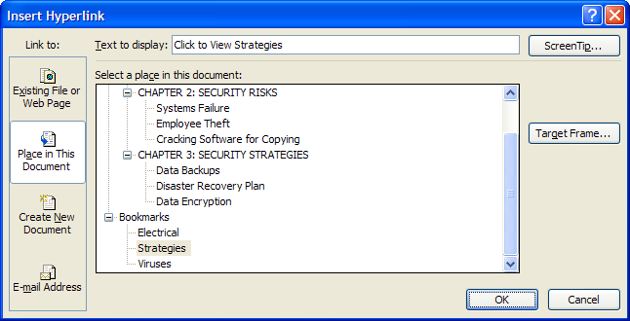
Creating Hyperlinks
Select text, then
Insert tab, Hyperlink
OR
Ctrl + K
Click to link to a location within this document
Click location in this document
Selected text will display as a hyperlink

Slide 27
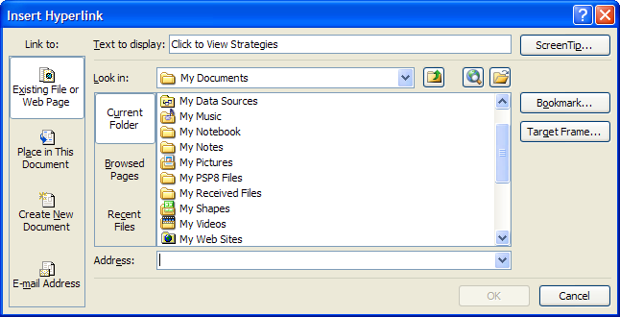
Creating Hyperlinks …/2
Select text, then
Insert tab, Hyperlink
OR
Ctrl + K
Click to link to a location outside this document
Navigate to file or web page
Selected text will display as a hyperlink

Slide 28

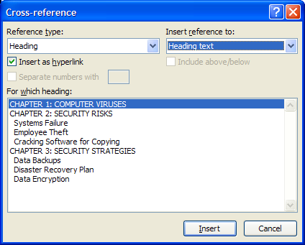
Creating a Cross-Reference
Cross-References
… refer reader to another location
within the document
… are inserted as hyperlinks
… can refer to numbered items, headers,
footnotes, endnotes, figures, tables,
bookmarks
Click Insert tab,
Cross-Reference
Choose reference type,
where to refer,
& specific text

Slide 29
Features Summary
What do you need to create a custom theme set?
Theme colors,
Theme fonts, and
Theme effects

Slide 30
Features Summary
How can you save your custom theme set?
Page Layout tab, Themes
After setting the
colors, fonts,
and effects,
click Save Current Theme…
Enter Name and click Save

Slide 31
Features Summary
How do you change a custom theme after it has been saved?
Click
Page Layout tab, Colors
OR
Page Layout tab, Fonts
Right-click
custom color or font set and choose Edit…

Slide 32
Features Summary
How do you create a custom style?
Select the text, click the
More button,
then click Save Selection as a New Quick Style
Name the style, modify
as needed, click OK.

Slide 33
Features Summary
How do you modify an existing style?
Right-click the Style to be changed
Click Modify…
Make changes, click OK

Slide 34
Features Summary
How do you apply an existing style?
Any of four ways:
1. Click desired style in ribbon
2. Select text,
Click desired style using Mini toolbar
3. Use Styles Task Pane
4. Apply Styles Window

Slide 35
Features Summary
How do you select all occurrences of a particular style?
Right-click the Style in the ribbon
Click

Slide 36
Features Summary
How can you reveal the formatting of text?
OR
Shift + F1
Click Show Preview

Slide 37
Features Summary
How can you create a bookmark?
Position insertion point,
Insert tab, Bookmark
Type a Name
and
Click Add

Slide 38
Features Summary
How do you display the Insert Hyperlink dialog box?
Insert tab, Hyperlink
OR
Ctrl + K

Slide 39
Features Summary
How do you insert a Cross-Reference in your document?
Insert tab,
Cross-reference

Slide 40
Coming Next
Chapter 5
REFERENCING AND SHARING INFORMATION

